Slide 1
Why Digital Strategies Fail
Group 28
-HERMAN WILLIAM
-KHOR AIK KHEANG
-KOH YEE HUEI
-YULIUS MULYADI HALIM
McKinsey Quarterly

Slide 2

Pitfalls of Digital Strategy
Unclear Definitions
Misunderstanding the Economics of Digital
Overlooking Ecosystems
Overindexing on the Usual Suspects
Missing the Duality of Digital

Slide 3
Unclear Definitions
companies struggle to connect digital strategy to their business
Adoption of analytics to improve automation, process and decision making → Brand new business model
No clear holistic understanding on what is digital
Digital must encompass “nearly instant, free, and flawless ability to connect people, devices, and physical objects anywhere”

Slide 4
Misunderstanding the Concepts of Digital
Digital strategy brings about innovative and disruptive way of providing similar service/product to the customer
Demise of the intermediaries as digital strategy cuts short the distance between the provider and the customer
Major shift in profit pools as digital leader will reap the most out of the market
Rewards the first mover/fastest follower as it gain upper hand in understanding the market and adjusting their strategy through learning advantage

Slide 5
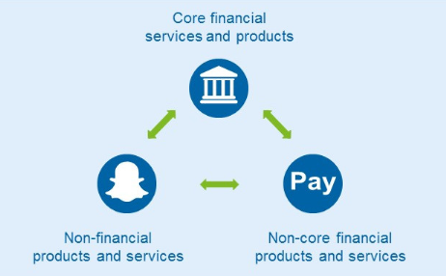
Overlooking Ecosystems
Digital strategy is to bring about an ecosystem that open avenues for cross functional products/services and collapsing industrial barriers

Slide 6

Overindexing on the Usual Suspects
Incumbent still hold an edge over digital new comer if it manage to embrace digital strategy successfully due to its lion share of the market
Although digital strategy seems to be focusing on B2C, businesses should not ignore the benefits of digitizing the B2B components

Slide 7

Missing the Duality of Digital
Digital strategy does not mean that businesses should ignore the existing business and create something new. Instead, it should be designed to leverage on existing business to create a synergy

Slide 8
Thoughts / Observations - Environment
First mover must be complemented with proper business strategy, e.g. Facebook vs. Friendster / MySpace
Follower vs. Pacesetter → Pacesetter must constantly revisit digital strategy to stay ahead in the disruptive world
Supportive political environment e.g Facebook vs Wechat

Slide 9
Thoughts / Observations - Economic
Good digital strategy does not mean good business model. Companies like Uber and Grab may have good digital strategy, but it may not be economically viable/unsustainable in the long run.
Overlooking the impact on medium size/start-up companies
The viability of subsidizing for the customer
The viability of depending on funding from venture capitalist to survive.

Slide 10
Thoughts / Observations - Organization
Organization structure needs to be aligned with the digital strategy, not the other way round
Lack of necessary knowledge to support the strategy. Management need to be all rounder to be able to formulate a comprehensive business strategy.
Importance of proper corporate communication strategy → cascading of the understanding of digital strategy and objective to all levels of the organization → resulting in flawless execution

Slide 11
Thoughts / Observations - Management
Management need to be agile and constantly on their feet to respond to the competitors. The standard business cycle of yearly strategic formulation and quarterly forecast will not work.
Management often spending too much time focusing on strategy and big picture, but lack the nuances on execution steps and success metrics.
Lack of continuity in digital strategy when management changes

Slide 12
Thank You
ANY QUESTIONS?

